Slide 1
Integrated circuit logic families
Presented by Jamil Rayhan
ID: 18CSE061

Slide 2
Introduction
Logic gates are available in the form of Integrated circuit( IC’s)
As per the level of integration, the IC’s can accommodate more number of logic gates and digital functions.
These forms are referred as logic family

Slide 3
Logic family
Logic Families indicate the type of logic circuit used in the IC.
A Circuit configuration or arrangement of the circuit elements in a special manner will result in a particular Logic Family.
The set of digital ICs belonging to the same logic family are electrically compatible with each other

Slide 4
Characteristics of logic families
The main characteristics of Logic families include:
Speed
Fan-in
Fan-out
Noise Immunity
Power Dissipation

Slide 5
Characteristics of logic families(cont.)
Speed: Speed of a logic circuit is determined by the time between the application of input and change in the output of the circuit.
Fan-in: It determines the number of inputs the logic gate can handle.
Fan-out: Determines the number of circuits that a gate can drive.
Noise Immunity: Maximum noise that a circuit can withstand without affecting the output.
Power: When a circuit switches from one state to the other, power dissipates.

Slide 6
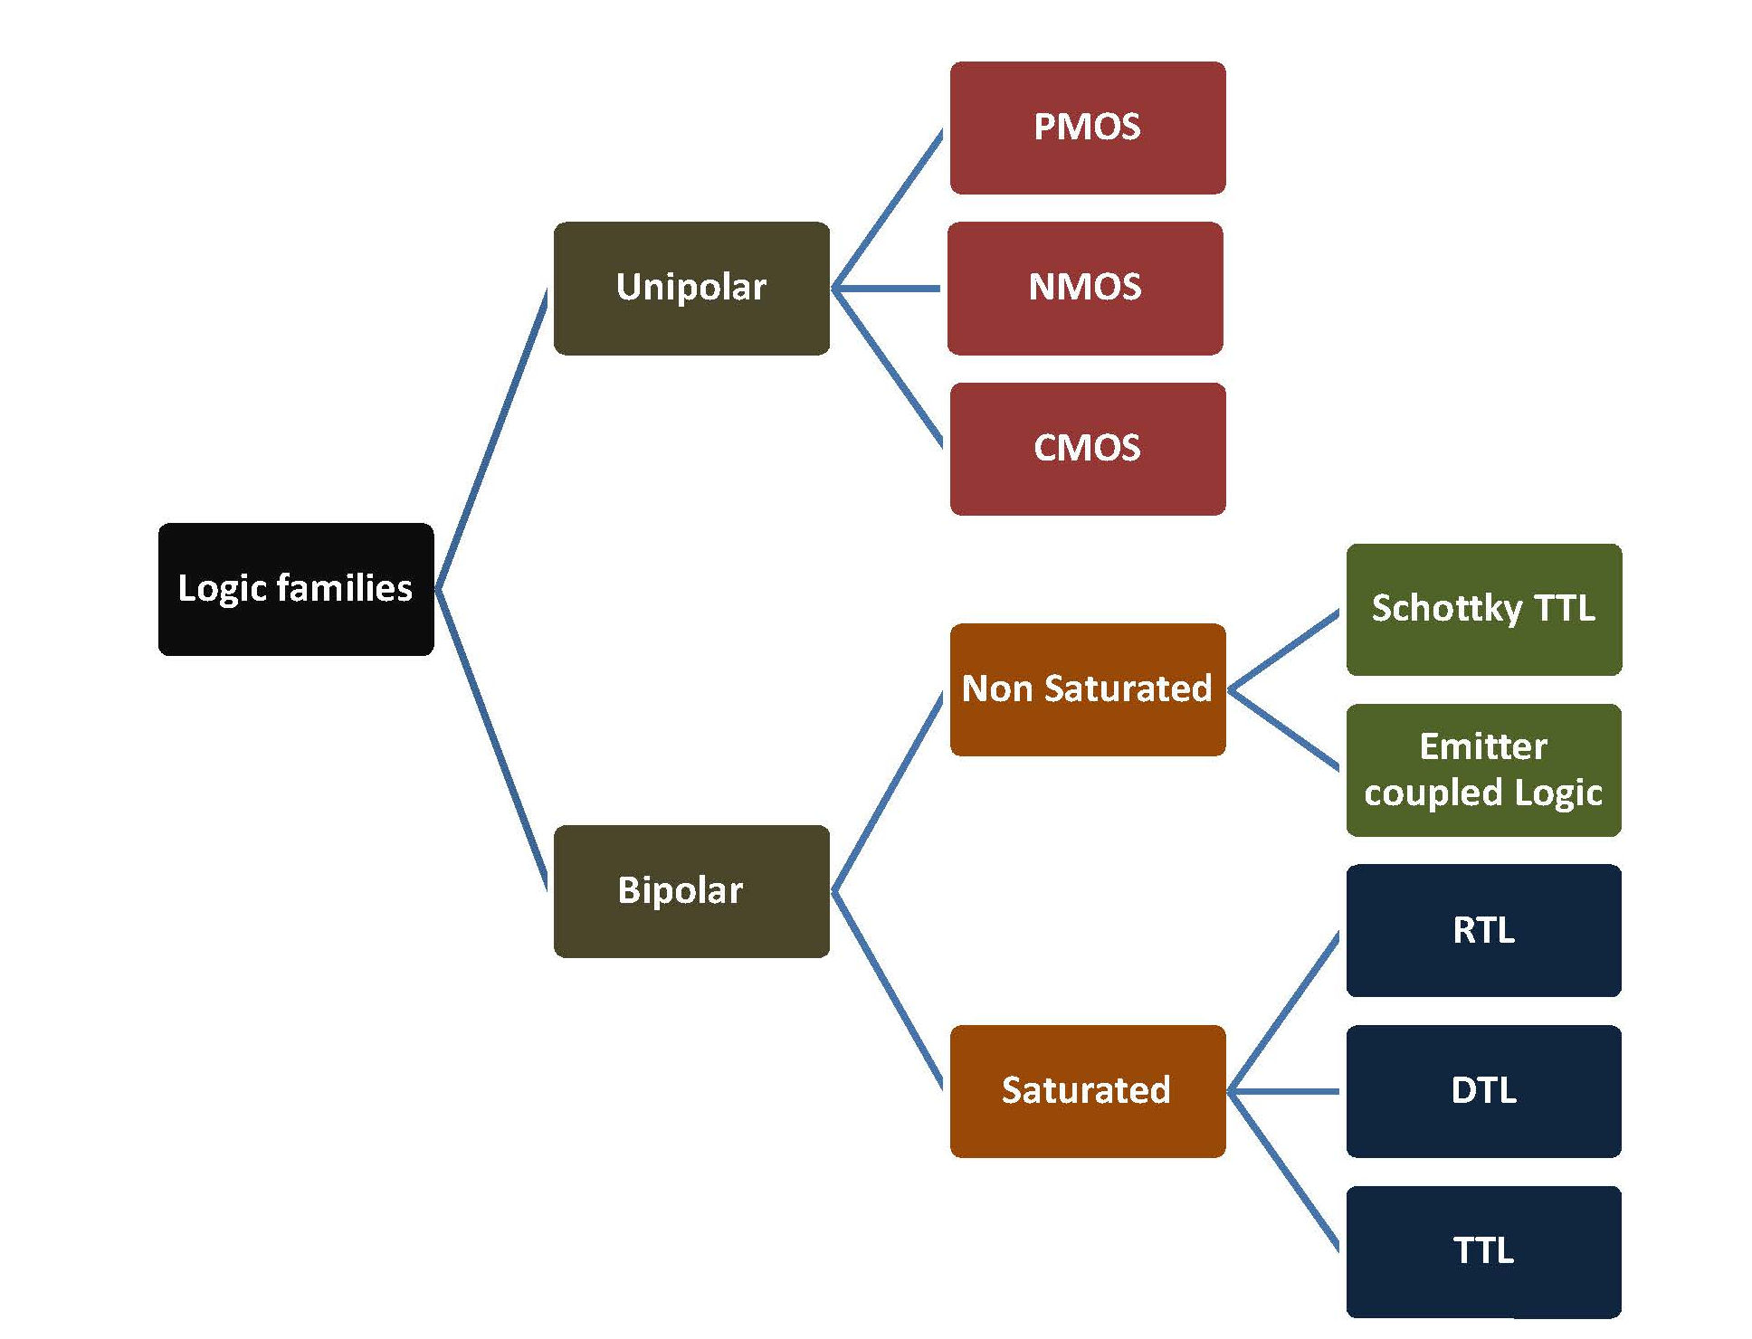
Basic classification of logic families

Slide 7
Unipolar Logic Families
Its stands for Metal Oxide Semiconductor.
In these MOSFETs (Metal oxide semiconductor field-effect transistor) are fabricated on chip.
It is used in LSI [Large scale integration] field because more MOSFETs can be packed into the same chip area.

Slide 8
Types of Unipolar Family
PMOS Family
NMOS Family
CMOS Family

Slide 9
CMOS
CMOS stands for “Complementary Metal Oxide Semiconductor”.
One of the most popular technology in computer chip design industry
Broadly used to form integrated circuits.
CMOS devices are chips in which both P-channel and N-channel enhancement MOSFETs are connected in a push-pull arrangement.

Slide 10
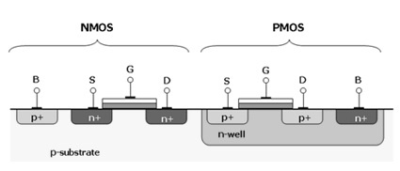
CMOS
Complementary Metal Oxide Semiconductor Transistor consist of PMOS and NMOS.

Slide 11
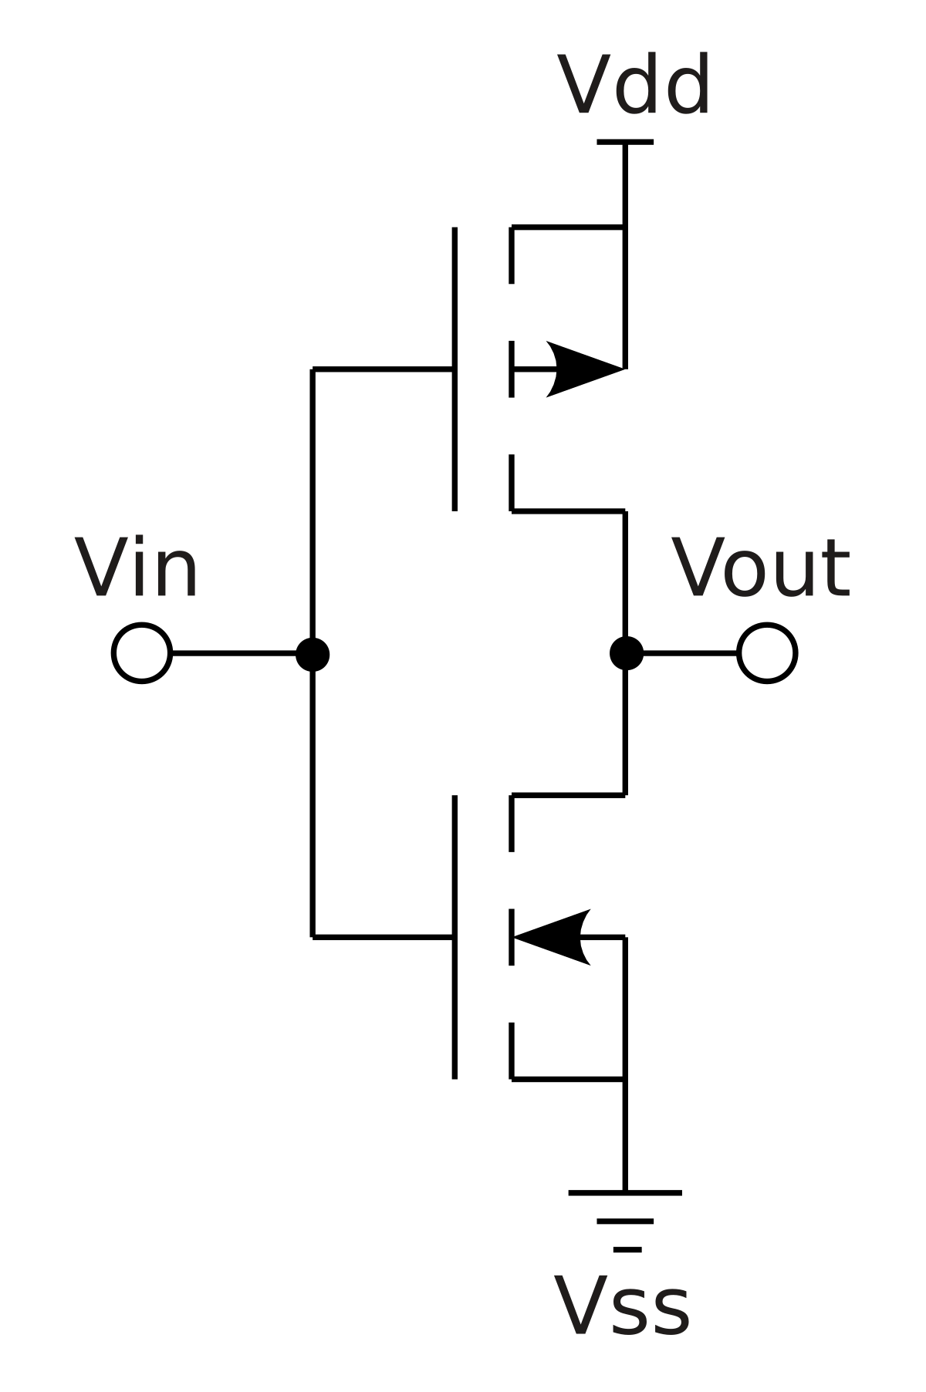
CMOS Inverter
Input | Logic Input | Output | Logic Output
0v | 0 | Vdd | 1
Vdd | 1 | 0v | 0

Slide 12
Applications
Technology like CMOS is used in different chips like,
Microcontrollers
Microprocessors
Static RAM(SRAM)
Data converters
Image sensors

Slide 13
Advantages of CMOS
The main advantage of CMOS is the much smaller power dissipation.
CMOS are simple , small in size ,cheaper in fabrication.
Reduce the complexity of the circuit.
High noise immunity.

Slide 14
Disadvantages of cmos
Not Bipolar
Some circuit are not practicable.
Difficult to implement.

Slide 15
Bipolar Families
Bipolar transistors are fabricated on a chip in digital integrated circuits.
Bipolar technology is preferred for SSI [ Small scale integration ] and MSI [ Medium scale integration ] because it is faster.

Slide 16
Types of Bipolar Families
Non Saturated
Schottky TTL
Emitter Coupled Logic(ECL)
Saturated
Resistor Transistor Logic (RTL)
Diode Transistor Logic (DTL)
Transistor- Transistor Logic (TTL)

Slide 17
What is TTL?
It’s a logic family built from Bipolar Junction Transistors.
Its name signifies that transistors perform both the logic function and the amplifying function.
Widely used logic family

Slide 18
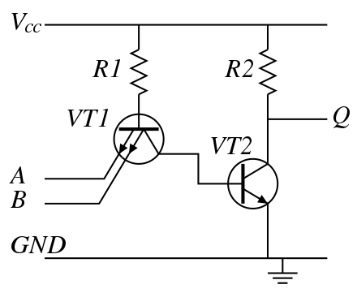
Transistor-Transistor logic
Two-input TTL NAND gate with a simple output stage

Slide 19
Advantages of TTL
TTL provides very high speed .
TTL is more reliable .
TTL needs lower power for any operation .
TTL can stack the transistors to make for fast pull up and pull down .
TTL circuits are not so complicated .

Slide 20
Disadvantages of TTL
Consumes more power compares to CMOS family and hence it is not suitable for battery powered devices over ECL and CMOS .
It has fan out of 10 which is less compare to CMOS .
Logic circuit having N fan out can drive N logic inputs.

Slide 21
Thank you

